Slide 1

Let’s take a class picture!

Slide 2

On Becoming a Leader in Risk Management
Fundamentals of RM
RM system and Process
Leadership in RM
Incident Investigation
RM Tools & Challenges
RM in Industry
People & Org.
Applications & Perspectives
ENGG404 – Final Lecture
Career Lessons
2
Notes:
ENGG404 Lecture 00 - Day 1
2012 Fall
2
2

Slide 3
Our Personal Lessons To You:
A few pointers to help you as you begin your careers:
Manage your Business:
The Engineer’s Survival Guide
Leadership in Risk Management
Manage Your Relationships:
Do Your Job
Work With Your Direct Supervisor:
Be a Professional!
Establish your professional values:
“Integrity. Initiative. Innovation. Industriousness.”
Be Competent
3
Notes:
3

Slide 4
1) Manage Your Business!
Can you become and be a “Leader in Risk Management?”
If you were asked these questions, how would you reply?
Q: “What is a Leader? What is a Manager?”
Q: “What is Leadership in Risk Management?”
… that’s what this course is about!
Manager | Leader
Keeps the organization going. | Leaders make things happen (in a good way) that would not have happened otherwise.
Maintains the “status quo”. | Envisions how the organization can improve, and works to improve and advance the organization.
Is satisfied with current performance. | Is proactive in “making things happen”.
4
Notes:
ENGG404 2014F
4
4
28 October 2019

Slide 5

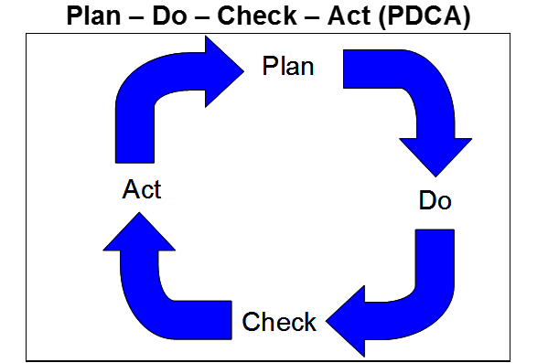
2) Manage Your Relationships!
Do your job:
You have professional responsibilities and are accountable!
Identify your objectives!
Execute all steps of the fundamental function of management.
5
Notes:
ENGG404 2014F
5
5
28 October 2019

Slide 6
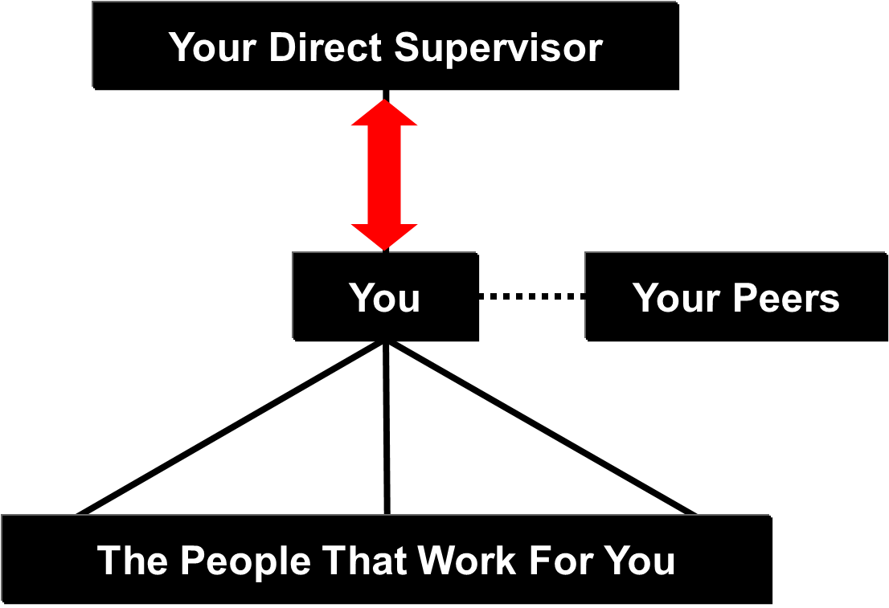
2) Manage Your Relationships!
Some practical advice to work with your direct supervisor:
Ensure you are meeting expectations, and managing your responsibilities such that there are “no surprises”!
Take the initiative to communicate. Seek clarity when directions clash with ethics, values, policies, etc. Keep your supervisor informed especially when things are not going per the plan.
Supervisors want solutions, not excuses, and not more problems.
FYI: Bosses want solutions! NOT excuses and NOT more problems!
ESRM - LRM
6
Notes:
6

Slide 7
3) Be a Professional!
Establish professional values:
Integrity: two “ideas” about of integrity!
Initiative: anticipate and get ahead of what is needed, and on what you can deliver!
Innovation: use your smarts to develop solutions.
Industriousness: put in the effort, but be smart about your work!
ESRM - LRM
7
Notes:
ENGG404 2014F
7
7
28 October 2019

Slide 8
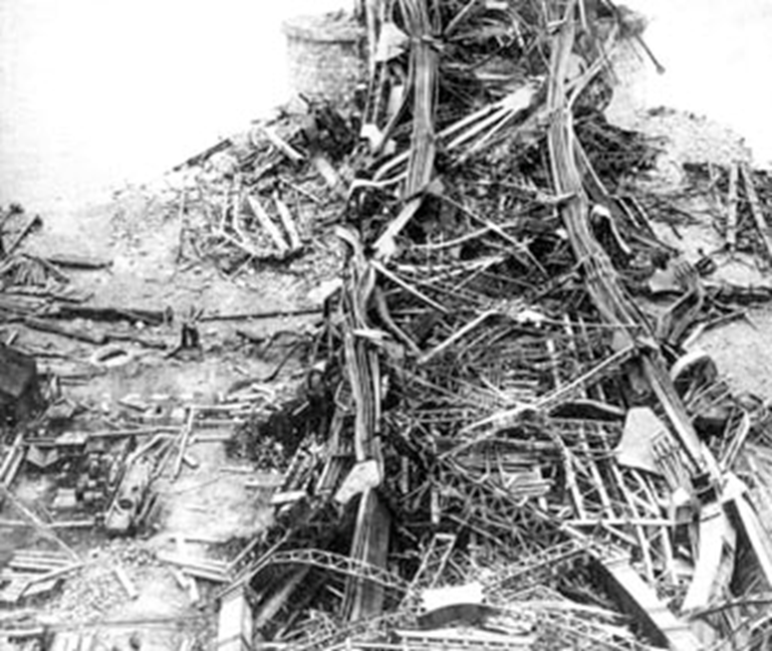
3) Be a Professional!
Be competent in your career!
Be proud of your profession’s achievements and contributions to society, but also of your own personal triumphs!
But don’t let your pride and arrogance get ahead of yourself.
You do not want to be the author of a case study.
Recall The Quebec Bridge Disaster, near Quebec City, August 29, 1907:
Reputations ruined
Capital investment lost
Two years to clean up.
75 workers were killed
… and the significance of your Iron Ring
8
Notes:
8

Slide 9
On Becoming a Leader in Risk Management!
This brings us to the conclusion of our lectures.
Your future employer will be well supported by your efforts in safety and risk management.
Thank you for your participation, and for your commitment to learning and applying the principles of engineering safety and risk management in your careers.
We sincerely wish you the best of success on all of your final exams and for a bright future in your careers!
It truly has been a privilege teaching you, and learning together with you.
Dr. White, Dr. Macciotta, Professor Coles, & Professor Cocchio
9
Notes:
9
9

